Slide 1

TVHC SKILLS TEST
Presented by Hector Sanchez

Slide 2
Introduction & Background
Why Blood Pressure Matters:
High BP is a major risk factor for strokes, heart disease, and kidney failure
It can go unnoticed without routine monitoring
BP Management can improve long term health outcomes
Clinical Interventions play a key role in improving BP control
“Nearly 1 in 2 U.S. adults has high blood pressure” – American Heart Association

Slide 3
OBJECTIVE & BACKGROUND
Assess the impact of various interventions on BP control
Compare pre- and post- intervention blood pressure metrics
Calculate the percentage of patients achieving BP control (systolic < 140 mmHg and diastolic < 90 mmHg) after intervention
Identify trends in outcomes by demographic characteristics and provider or site

Slide 4
KEY FINDINGS SUMMARY
What I Discovered:
60% of patients achieved controlled BP post-intervention; 25% misclassified, risking missed follow up
Clinical Pharmacy Program led with 81.8% control, followed by Health Coaching(76.9%) and Medication Adjustment (75%); some interventions below 41%
BP control varied by site (52%-71%) with Site A accounting for 56% of misclassification errors
Demographic Disparities
Males (63.8%) > Females (54.8%)
Medicare/uninsured(~56%) < Medicaid/commercial (~63%)
BP Control declines with age: 74% (30-44 yrs) -> 48% (60-74 yrs)

Slide 5
BEFORE & AFTER RESULTS
Blood Pressure Improvements After Intervention
Average Systolic BP dropped by 8.25 mmHg (~6% decrease)
Average Diastolic BP dropped by 3.68 mmHg) (~4% decrease)
Blood Pressure Improvements by Intervention
Clinical Pharmacy Program
Systolic ↓ 11.00 mmHg (8.06%) and Diastolic ↓ 4.91 mmHg (5.52%)
Medication Adjustment
Systolic ↓ 10.75 mmHg (7.81%) and Diastolic ↓ 4.58 mmHg (5.11%)
Health Coaching
Systolic ↓ 8.77 mmHg (6.26%) and Diastolic ↓ 3.62 mmHg (4.00%)
Home BP Monitoring
Systolic ↓ 6.00 mmHg (4.34%) and Diastolic ↓ 3.73 mmHg (4.18%)
Care Team Outreach
Systolic ↓ 4.65 mmHg (3.36%) and Diastolic ↓ 1.81 mmHg (2.01%)

Slide 6
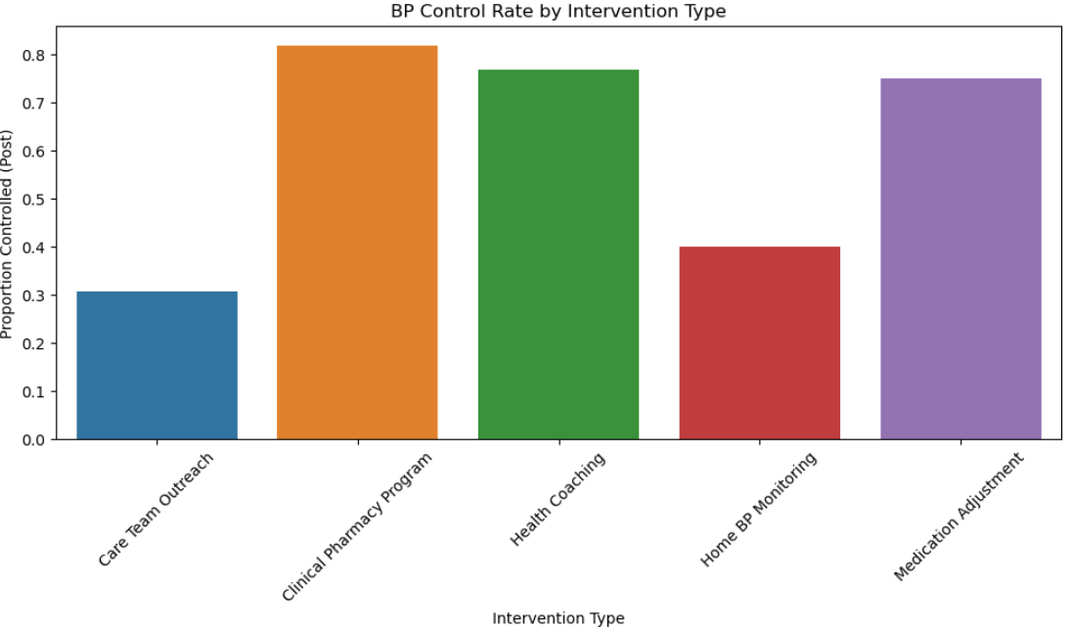
INTERVENTION EFFECTIVENESS

Slide 7
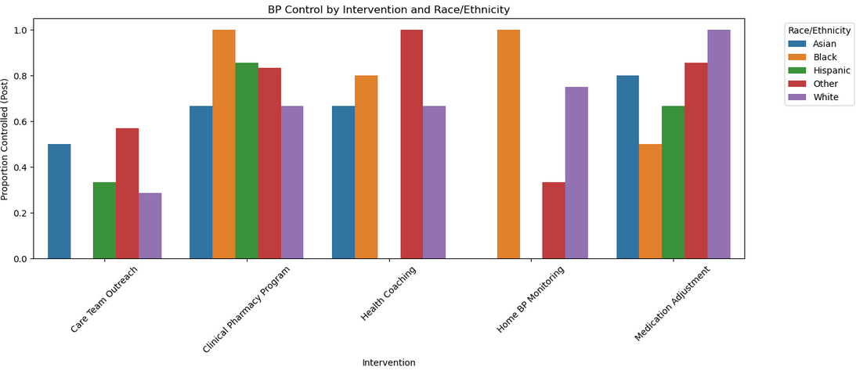
INTERVENTION EFFECTIVENESS

Slide 8
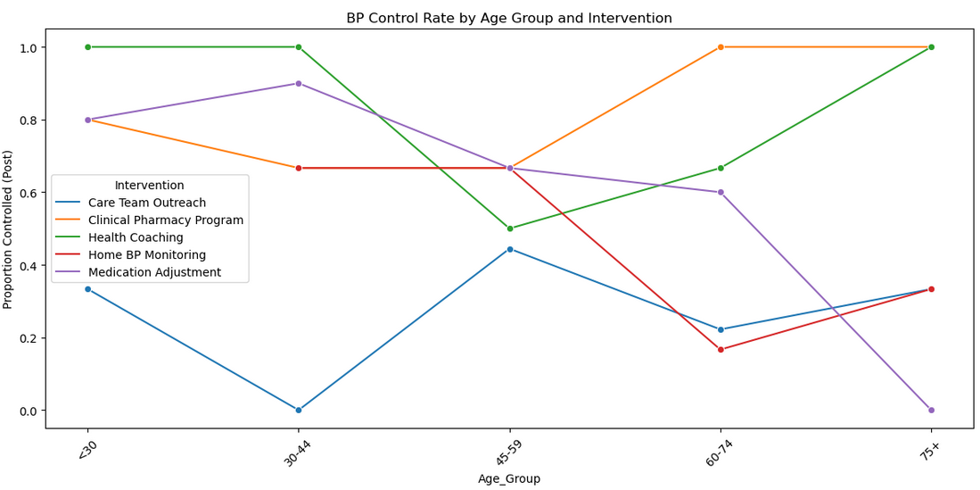
INTERVENTION EFFECTIVENESS

Slide 9
EQUITY & DEMOGRAPHICS
Who Benefits Most?:
Males: Higher BP Control (63.8%)
Clinical Pharmacy Program was effective across ALL race groups
Medicaid patients: Strong outcomes across most interventions (100% in some)
Who Needs More Support?:
Females: Lower BP control (54.8%)
BP Control declined with age: 74% in ages 30-44 and 48% in ages 60-74
Medicare & Uninsured: Lower control (~56%) and less consistent success

Slide 10
RECOMMENDATIONS
Improve Data Quality
Standardize BP control classification across sites to reduce misreporting
Expand Access to High-Impact Interventions
Scale up effective interventions for broader patient reach
Target At-Risk Populations
Tailor interventions for subgroups with lower BP control
Standardize Best-Practices Across Sites
Apply workflows and staffing models from high-performing sites
Enhance Reporting Metrics
Include mean BP change and percent improvement in dashboards for a more complex view of clinical progress

Slide 11
QUESTIONS?

Slide 12
THANK
YOU

